Slide 1

DEPARTAMENT OF COMPUTER SCIENCE & ENGINEERING Mini Project Presentation EMPLOYEE TASK MONITORING USING ANDROID APPLICATION PRESENTED BY
KOMARAVOLU J S S V ABHIRAM (17WJ1A05F4)
KORIVI NIKHIL (17WJ1A05F5)
Under the Guidance of Mr.Sk.BADARSHA
Asst.Prof
Dept.CSE

Slide 2
ABSTRACT
Smart scheduling for project management is to Schedule and manage task/work/events quickly by checking status in a single view. The proposed smart scheduling can create the dynamic/multiple task with start, end date and alter every task that has start and completion dates that take the task interdependencies into account. A milestone is accomplished when one or more work products from an engineering task have passed quality review. The software implemented in mobile app. It takes care of the activities that are scheduled and helps in the management of daily tasks of the employees in the organization. In a company where the hierarchy of employees spans over thousand managing the work with them is a difficult job. And in an environment where number of jobs is done simultaneously picking the right person for the job is also difficult task, as you are not aware of their availability. This application is designed for such an environment where the work is divided into group of employees and during the course of division the employees are selected to be part of the work in hand.

Slide 3
INTRODUCTION
The Online Task Management System is used to automate the process of admin and user management and user task. The work is under observation of the higher authorities. The project provides online platform to accomplish day to day task in an organization. The proposed software will help the employee and admin to communicate with each other. The system easily assigns tasks so as to avoid all the time-consuming and unnecessary meetings. Admin can periodically share all the details regarding the task with the employee. The management of assignment or task is easy from both the ends . The admin is able to assign task to the employee. This software provides facilities to assign task, send message, send and view notification to the users of this software.

Slide 4
LITERATURE REVIEW
Title : Using a Risk Breakdown Structure in project management
Author : D. A. Hillson
Year : 2013
Description:
Risk identification often produces nothing more than a long list of risks, which can be hard to understand or manage. The list can be prioritised to determine which risks should be addressed first, but this does not provide any insight into the structure of risk on the project. Traditional qualitative assessment cannot indicate those areas of the project which require special attention, or expose recurring themes, concentrations of risk, or ‘hot‐spots’ of risk exposure. The best way to deal with a large amount of data is to structure the information to aid comprehension.

Slide 5
LITERATURE REVIEW
For risk management, this can be achieved with a Risk Breakdown Structure )RBS) a hierarchical structuring of risks on the project. The RBS can assist in understanding the distribution of risk on a project or across a business, aiding effective risk management. Just as the Work Breakdown Structure (WBS) is an important tool for projects because it scopes and defines the work, so the RBS can be an invaluable aid in understanding risk. The WBS forms the basis for many aspects of the project management process; similarly, the RBS can be used to structure and guide the risk management process. This paper presents the concept of the RBS, and gives a number of examples drawn from different project types and industries. Although not necessarily based in FM, the concepts and experience can be applied to any project. The benefits of using the RBS are then outlined, including as an aid for risk identification or risk assessment, comparison of projects, providing a framework for cross‐project risk reporting, and structuring lessons to be learned for future projects. This paper shows how to use the RBS to gain these benefits.

Slide 6
LITERATURE REVIEW
Title : Organisational Complexity and Perceptions of Task
Author : S. McKenna
Year : 2013
Description:
This paper explores the idea that risk, rather than being a linear, objective and manageable concept, is actually created, re-created and constructed. The construction of risk takes place within the constant sense-making that occurs in organizational life. Risk is, therefore, a complex phenomenon, and one that cannot be fully subjected to objective and rational analysis. Indeed, because risk is created through the ways in which reality is constructed by members of the organization, such risks are not 'real' but rather based on assumptions and perceptions. This paper, then, investigates the non-linearity and non-rationality of risk creation, and thus the difficulty of managing some risks in a linear and rational manner. The linearity of risk management techniques, as proposed in much of the literature, often creates a facade of order and control that do not exist in an essentially constructed and complex organizational world

Slide 7
LITERATURE REVIEW
Title : Time and Risk Management of International Projects
Author : A. Aleshin
Year : 2014
Description:
This paper proposes a mathematical model supporting the management of project risk. The model distinguishes between risks which have to be accepted and risks which can be eliminated at some cost, helping to decide which risks should be eliminated so that the customer requirements with respect to project completion time can be satisfied at minimal cost. The model is based on a modification of the PERT method and can be reduced to a mixed linear programming problem. The model is illustrated by means of a real world case concerning a construction project.

Slide 8
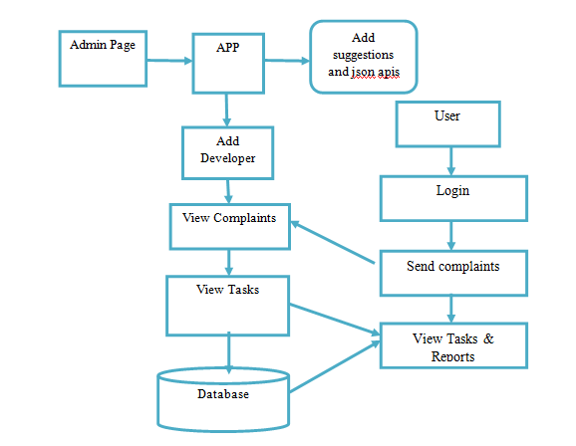
ARCHITECTURE DIAGRAM
SYSTEM ARCHITECTURE

Slide 9
EXISTING SYSTEM
In Existing System is that it can only keep track of tasks Manually.
Should visit every person to check the task is completed or not.
It consumes time.
It uses Many resources
Hard to maintain the records of Task manually

Slide 10
EXISTING SYSTEM
DISADVANTAGES :
No proper work report of employees.
No proper maintenance of employees.
Paper work is more.
Team leader cannot have proper information of employees

Slide 11
PROPOSED SYSTEM:
Task management system commonly offers communication tools that can assist teams in discussing issues in real time.
The benefit is that each team member can be kept up to date, quickly dealing with issues as they arise.
For projects that require the use of significant documentation, document sharing tools allow individuals.
Controlling costs is one of the most important benefits of project management.
Project management software generally includes tools that can assist in managing project costs.

Slide 12
PROPOSED SYSTEM:
ADVANTAGES:
All employees are structured properly.
Work progress of each employee is calculated.
Work progress of each employee is monitored.

Slide 13
PROBLEM STATEMENT
Difficulty in maintaining work report of employees.
Difficulty in assigning projects to employees.
Paper work is more to maintain records of employees of the organization.

Slide 14
OBJECTIVES
In a company where the hierarchy of employees spans over thousand managing the work with them is a difficult job.
In an environment where number of jobs is done simultaneously picking the right person for the job is also difficult task, as you are not aware of their availability.
This application is designed for such an environment where the work is divided into group of employees and during the course of division the employees are selected to be part of the work in hand.

Slide 15
MINIMUM SYSTEM REQUIREMENTS
SOFTWARE REQUIREMENTS:
Operating System : Windows 7 or further
Platform : Android Studio
Programming Language : Java 8
Database : H2console
HARDWARE REQUIREMENTS:
Processor : i3 PROCESSOR
Ram : 4GB RAM
Hard disk : 250/160 GB

Slide 16
MODULES
User Interface
Admin
Developer

Slide 17
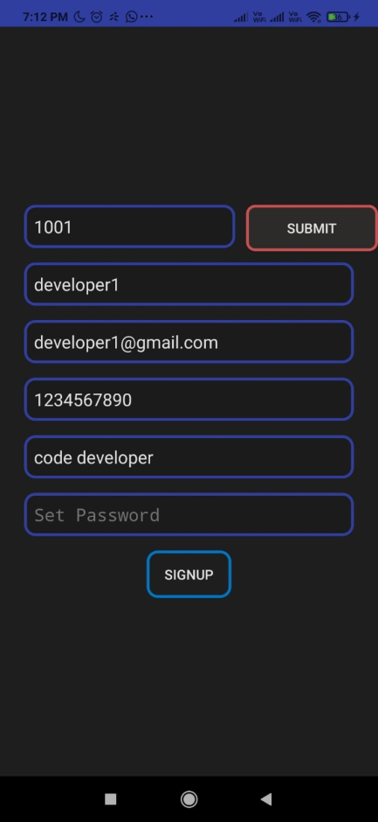
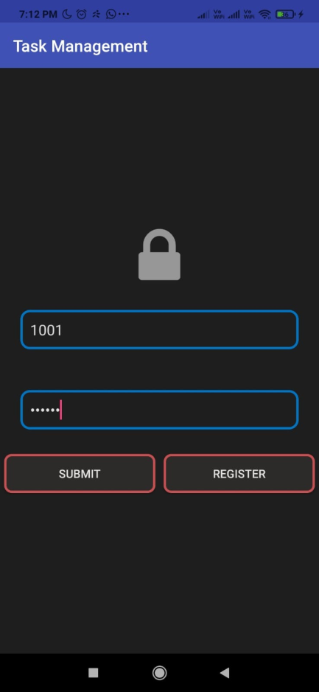
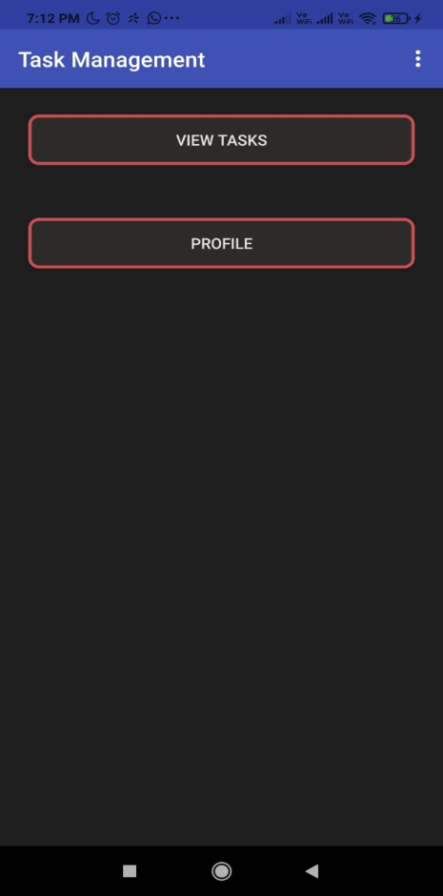
SNAPSHOTS
Signup page
Submit or register page
Employee login Success

Slide 18
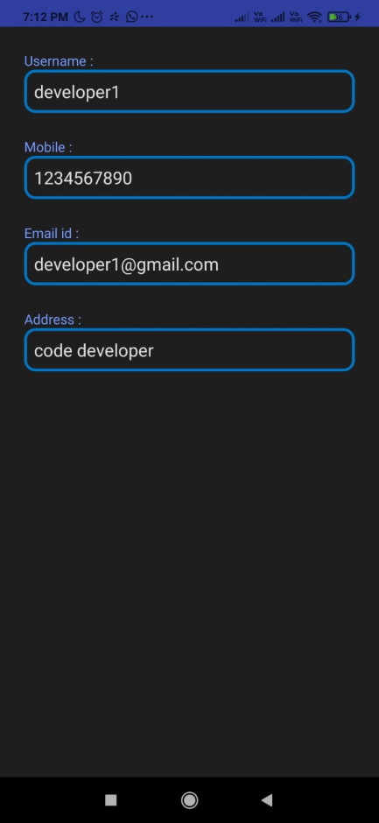
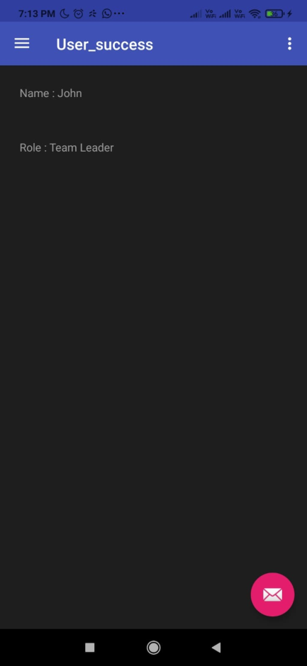
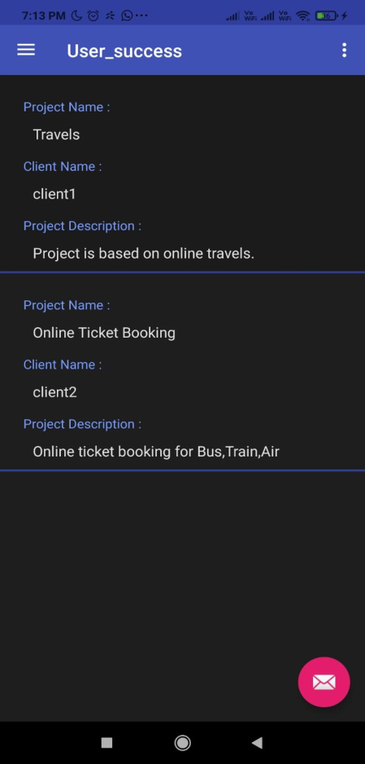
Employee Profile
User Success Page
Projects Page

Slide 19
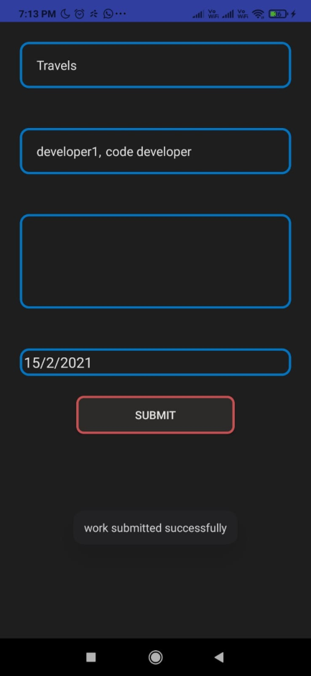
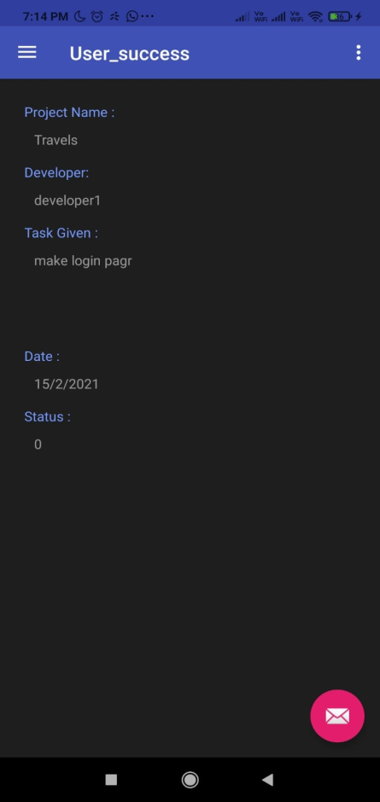
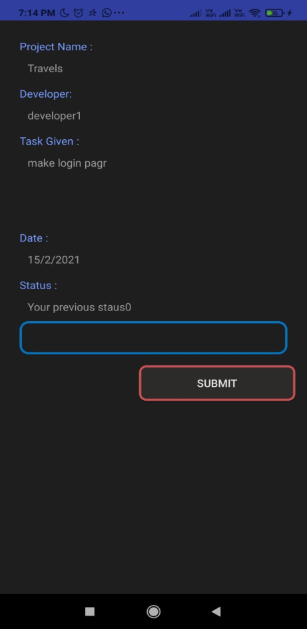
Assign Projects Page
View Status Pages

Slide 20
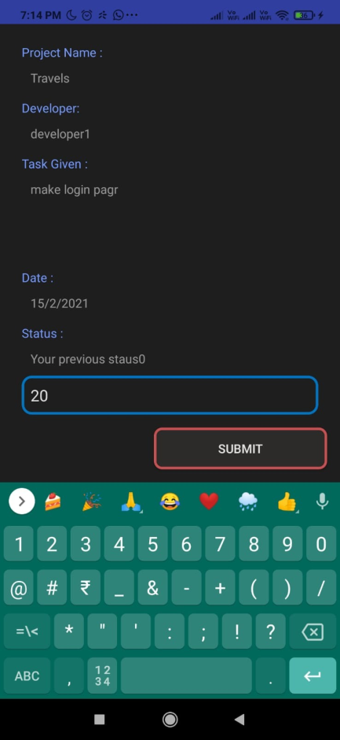
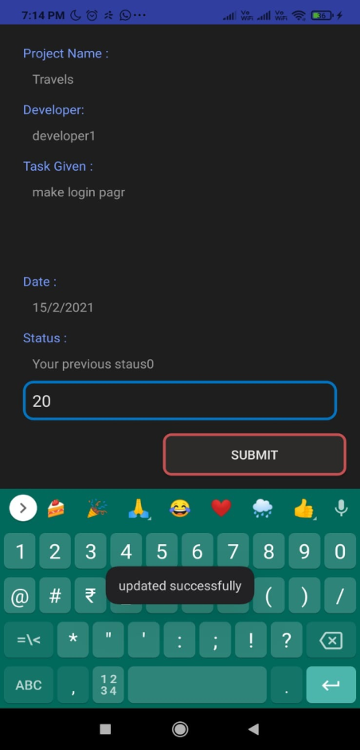
View Status Pages

Slide 21
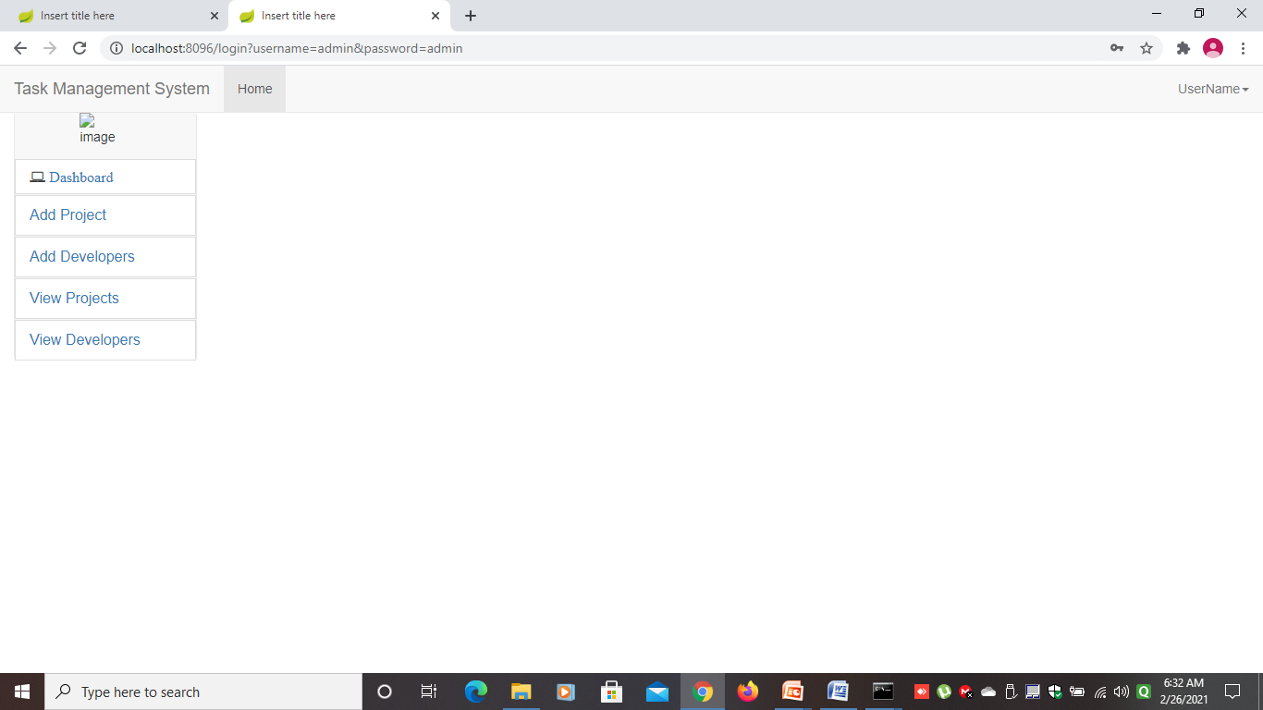
Admin Page

Slide 22
FUTURE ENHANCEMENT
Each and every day the government of India requires a new system of updating to update peoples welfare, these sorts of welfare updates will be succeeded by providing a new system of service, a service will be perfected by systematical procedures in this project a new scope of a mobile system has been introduced, although the project has been perfected still all department has to be bring under one shelter like hospital law and civil departments and these system will be brought up by the future development taking time under concern my proposal will stop under particular point

Slide 23
CONCLUSION
The developed project is a tasks reminder app, with AI-powered chatbot that will make user enjoy productivity. Whether your goal is to make good habits or get rid of bad ones. This application helps you to make sure that the tasks you set actually get done, with the help of its AI assistant. It monitors your android phone, pings you at times you’re likely to see a notification and makes sure you don’t forget about items on your to-do list. With this, which is one of the bot characters, this app brings you not only your tasks reminder but also a free productivity assistant that engages you throughout the day to create a more productive version of yourself.

Slide 24
REFERENCE
[1] Android Studio 2 Development Essentials, Book by Neil Smyth.
[2] PHP and MySQL Web Development, Book by Luke Welling, 2001
[3] D. A. Hillson, "Using a Risk Breakdown Structure in project management", Journal Of Facilities Management, vol. 2, no. 1, pp. 85-97, 2013.
[4] D. A. Hillson, "Using a Risk Breakdown Structure in project management", Journal Of Facilities Management, vol. 2, no. 1, pp. 85-97, 2013.
[5] S. McKenna, "Organisational Complexity and Perceptions of Task", Task Management: An International Journal, vol. 3, no. 2, pp. 53-64, 2013.
[6] A. Aleshin, "Time and Risk Management of International Projects", International Journal of Project Management, no. 19, pp. 207-222, 2014
[7] J. Ellis, L. Kvavilashvili, "Prioritization of tasks in 2000: Past present and future directions", Task Management, vol. 14, pp. 1-9, 2000.
[8] Drake Baer, "Dwight Eisenhower Nailed A Major Insight About Productivity", Business Insider, 2014.

